Slide 1
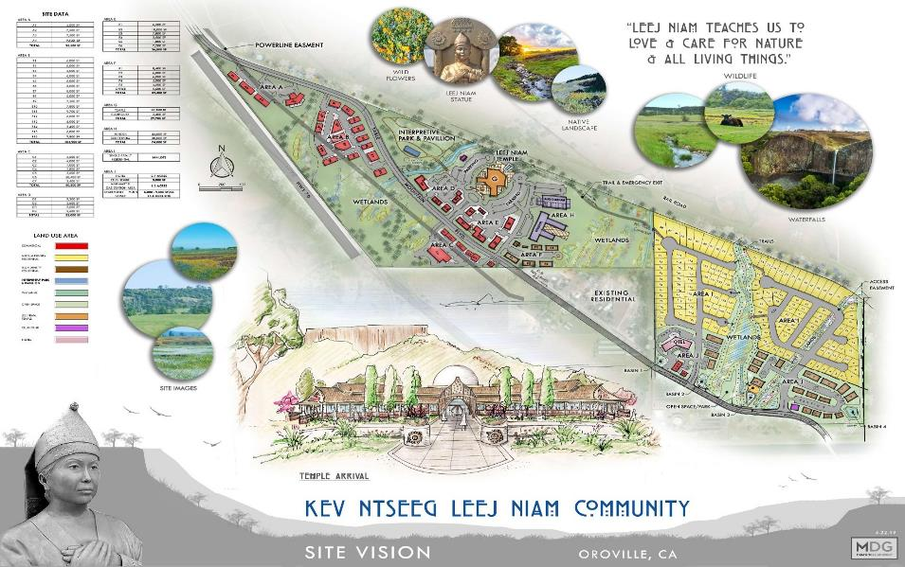
ZOS HMOOV NTUJ – SITE VISION/PLAN
(210 ACRES – OROVILLE, CA)

Slide 2
ZOS HMOOV NTUJ – LAND USE PLAN
(210 ACRES – OROVILLE, CA)

Slide 3
?
ZOS HMOOV NTUJ (PROJECT STATUS)
Pre-purchase
Seek Land/Housing Site
Finance in Place
Concept Stage
What’s on the site?
Temple, Residential, & Commercial Bldgs
Open Spaces / Restrictions
Purchase
Buy the land
Zoning for Residential and Commercial
The Development Process (210 Acres – Oroville, CA)
Town Planning / Development Approval Stage
Architectural/Land Surveyor/Plot Dimensions
City development guidelines
Development Approval Permit
Working Drawing/Documentation
Architectural and Engineering Construction Documents
Pre-construction
Acquire/hire Builders (and their subs)
Bank approval for development loan
Procurement Stage (Buying equipment)
Construction
Construction starts
Pay your builders progressively by completion phases using draw downs from your bank
Completion and Post Construction
Sell or lease your property for revenue
Occupancy / Close-out
Green = Completed, Yellow = In Progress, Red = To be Done

Slide 4

ZOS HMOOV NTUJ – ESTIMATED COST

Slide 5
ZOS HMOOV NTUJ – STATUS & NEXT STEPS
Status and Next Steps
City
Planning
Project Phases / Timeline
Marketing Message
Fund Raising / Message
Finance
Others
Project Status & Next Steps

